Slide 1
CSE 881: Data Mining
(Course Project)

Slide 2
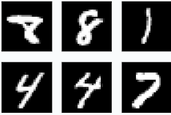


Graph Data Analytics
Traditional approaches are designed for simple grids or sequences
Tubular data
Fixed-size images/grids
Text/sequences
IID data (Independent and identically distributed)
(a) Records
(b) Images
(c) Documents

Slide 3
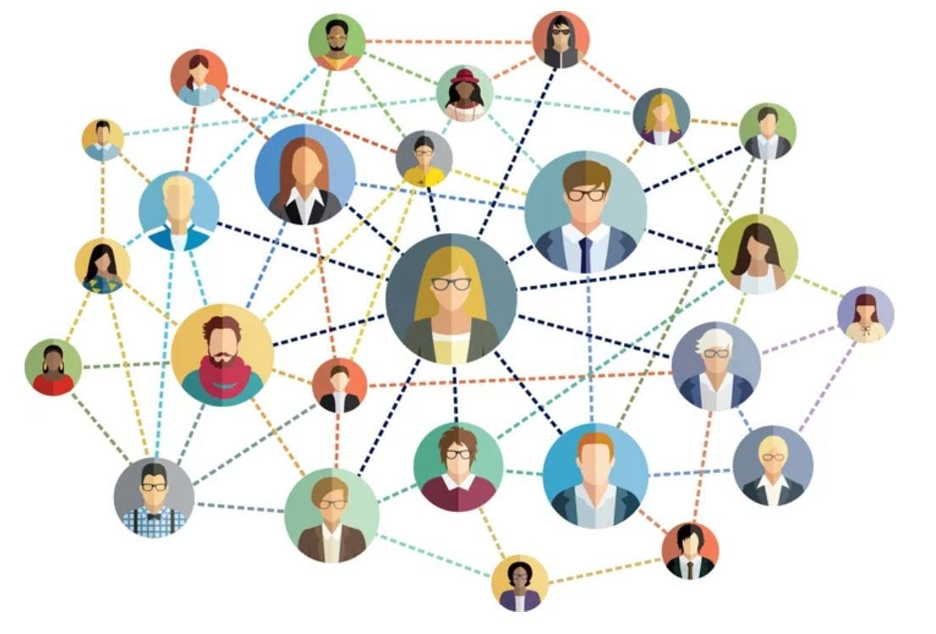
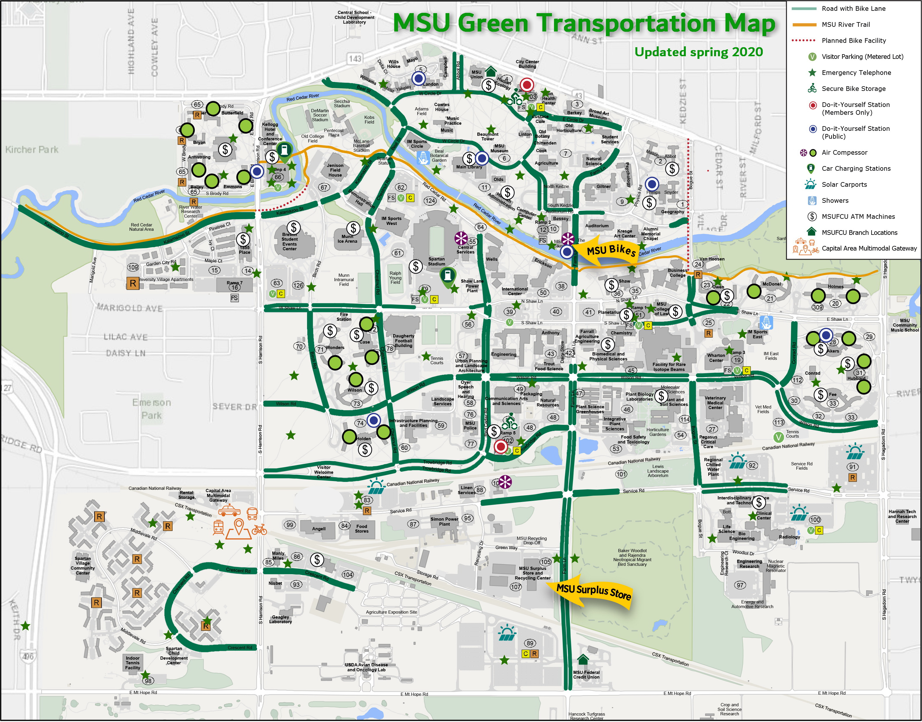
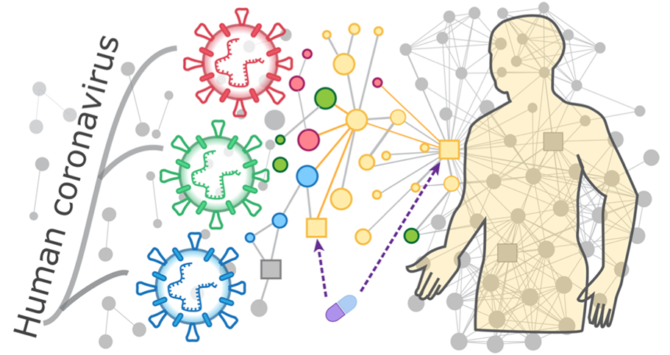
Graph Data Analytics
But nodes within graphs are connected
Non-IID data
Arbitrary neighbor size
Complex topological structure
Rich node/edge features
Social network
Transportation system
Protein-protein interaction (PPI)

Slide 4
Deep Learning on Graphs
Intuition: There should be some reasons why two nodes are connected
IID data
Non-IID Graph data

Slide 5
Deep Learning on Graphs
Intuition: There should be some reasons why two nodes are connected
In addition to node feature/attributes, how can we capture the information from node connections?
Edge/link
IID data
Non-IID Graph data

Slide 6
Deep Learning on Graphs
Intuition: There should be some reasons why two nodes are connected
In addition to node feature/attributes, how can we capture the information from node connections?
Edge/link
IID data
Non-IID Graph data
Key idea: Leverage the information of neighbors

Slide 7



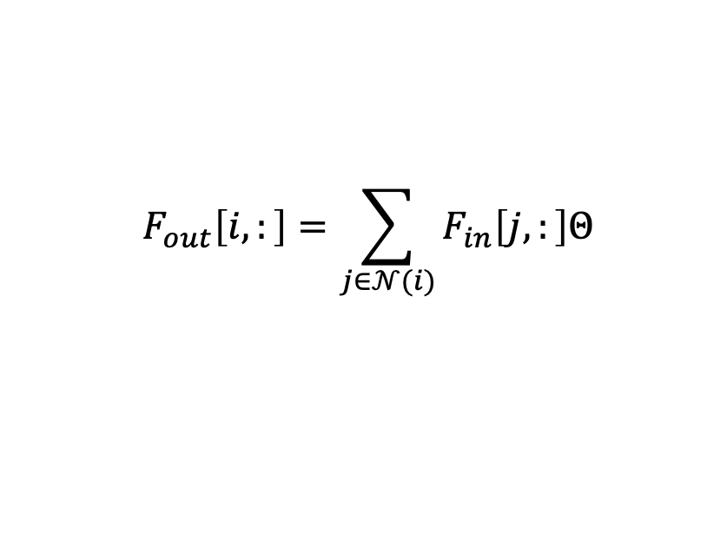














Graph Neural Networks
Message Passing
Feature Aggregation: Aggregate information from neighbors
For node $v_{i},$ ${ F}_{out}\left[i,:\right]=\sum_{j∈𝒩(i)}{F_{in}\left[j,:\right]}$
$𝒩(i)$: The neighbor set of node $i$
$${ F}_{out}\left[i,:\right]=\sum_{j∈𝒩(i)}{F_{in}\left[j,:\right]Θ}$$
$$F[3,:]$$
Feature transformation
$$v_{3}$$
$$v_{4}$$
$$F[4,:]$$
Feature Aggregation
$$F[1,:]$$
$$v_{1}$$
$$F[2,:]$$
$$F[5,:]$$
$$v_{5}$$
$$v_{2}$$
$$v_{8}$$
$$F[8,:]$$
$$F[6,:]$$
$$v_{6}$$
$$v_{7}$$
$$F[7,:]$$

Slide 8











Graph Neural Networks
Feature Aggregation in Matrix Form
For node $v_{i},$ ${ F}_{out}\left[i,:\right]=\sum_{j∈𝒩(i)}{F_{in}\left[j,:\right]}$
$$ℝ^{N×N}$$
$$ℝ^{N×H}$$
$$v_{3}$$
$$v_{5}$$
$$v_{8}$$
$$v_{1}$$
$$v_{1}$$
$$F[3,:]$$
$$v_{3}$$
$$v_{4}$$
$$F[4,:]$$
$$F_{in}$$
$$F[1,:]$$
$$F_{out}$$
$$A$$
$$v_{1}$$
$$F[2,:]$$
$$F[5,:]$$
$$v_{5}$$
$$v_{2}$$
$$v_{8}$$
$$F[8,:]$$
$$F[6,:]$$
Adjacent matrix
$$v_{6}$$
$$v_{7}$$
$$F[7,:]$$

Slide 9
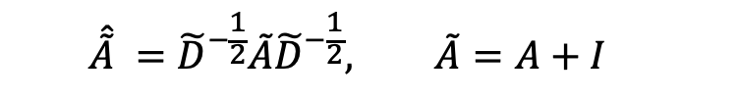

Graph Convolutional Network (GCN)
Multi-layers message passing with non-linear activation function
Leverage the normalized adjacent matrix
$$F^{(l+1)}=σ\left(GCN\left(F^{(l)}\right)\right) where l=1,2,⋯,L$$
$$\hat{\tilde{A}} ={\tilde{D}}^{−\frac{1}{2}}\tilde{A}{\tilde{D}}^{−\frac{1}{2}}, \tilde{A}=A+I$$
$$GCN\left(F^{(l)}\right)=\hat{\tilde{A}}F^{(l)}$$

Slide 10
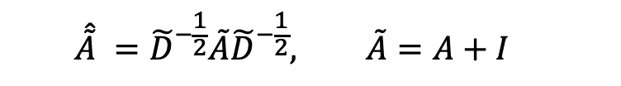
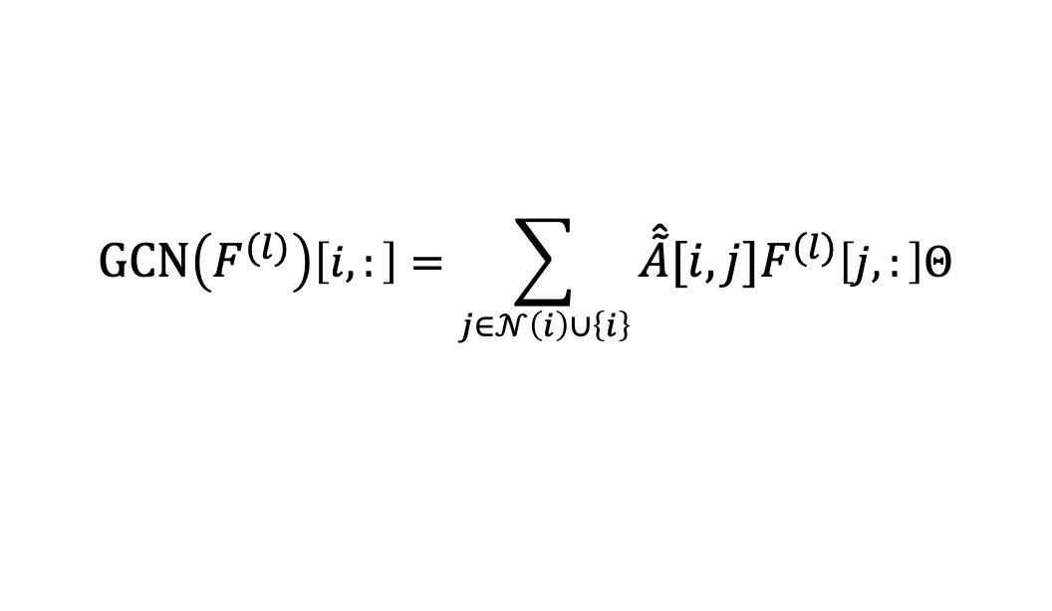

Graph Convolutional Network (GCN)
Multi-layers message passing with non-linear activation function
Leverage the normalized adjacent matrix
$$F^{(l+1)}=σ\left(GCN\left(F^{(l)}\right)\right) where l=1,2,⋯,L$$
$$\hat{\tilde{A}} ={\tilde{D}}^{−\frac{1}{2}}\tilde{A}{\tilde{D}}^{−\frac{1}{2}}, \tilde{A}=A+I$$
$$GCN\left(F^{(l)}\right)=\hat{\tilde{A}}F^{(l)}Θ^{\left(l\right)}$$
$$GCN\left(F^{(l)}\right)\left[i,:\right]=\sum_{j∈𝒩\left(i\right)∪\left\{i\right\}}{\hat{\tilde{A}}[i,j]F^{(l)}\left[j,:\right]Θ}$$
“Semi-Supervised Classification with Graph Convolutional Networks”, ICLR 2017

Slide 11
Transductive Node Classification
Input: entire graph with all nodes
You can use the whole graph for training
Train and test sets of nodes
You are allowed to split the train set into train&validation set for hyperparameter searching
Only the training nodes have labels, but you can use the whole structure information
Key information
Node features
Graph structure

Slide 12
Transductive Node Classification
Input: entire graph with all nodes
You can use the whole graph for training
Train and test sets of nodes
You are allowed to split the train set into train&validation set for hyperparameter searching
Only the training nodes have labels, but you can use the whole structure information
Key information
Node features
Graph structure

Slide 13
Some General Suggestions
Key information in the graph
Node features
Graph structure
Data shuffling for training set
Mini-batch training
Yes!
Whole-batch training
Not necessary
Don’t shuffle the test data! (‘idx_test’)
This is the most possible reason that your results are random!

Slide 14
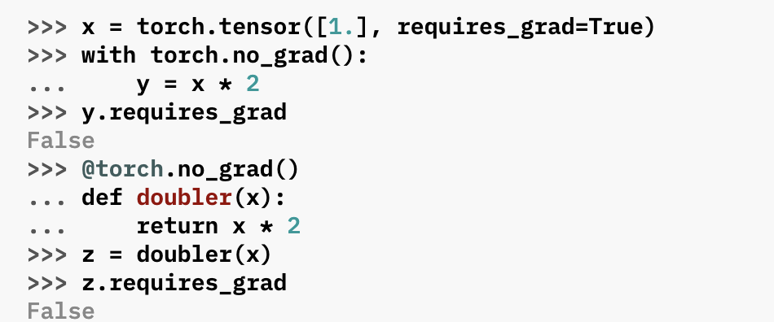
Some General Suggestions
Training & Inference
model.train() & model.eval()?
x = F.dropout(x, p=dropout, training=self.training)
model.train() will set self.training to True
model.eval() will set self.training to False
Inference

Slide 15
Some General Suggestions
No validation set
It might cause overfitting
You can split the train to the train-validation
from sklearn.model_selection import train_test_split
Or you can use cross validation
sklearn.model_selection.Kfold
sklearn.model_selection.StratifiedShuffleSplit

Slide 16
Some General Suggestions
Model Selection
Select the model that achieves best validation accuracy
Evaluate the validation performance at each epoch
Save the model or save the test results

Slide 17
Some General Suggestions
Data Preprocessing
Feature Engineering
Normalization
Graph Augmentation
Training
Learning rate scheduling
Early stopping
Cross-validation

Slide 18
Some General Suggestions
Different models
Graph neural network (GNNs)
GCN, GAT, GraphSgae, APPNP, GCNII
Graph transformer
Large language models (LLMs)
Dimensionality reduction, SVM, linear regression, model ensemble, etc.

Slide 19
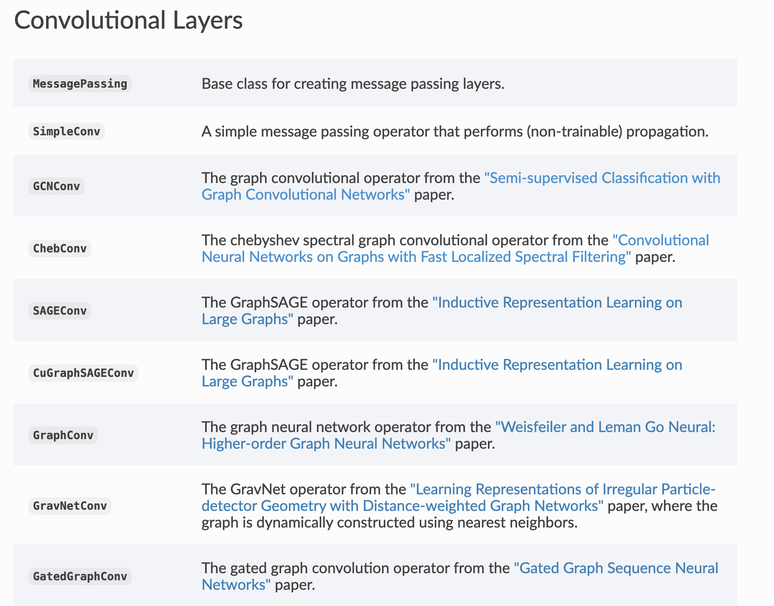
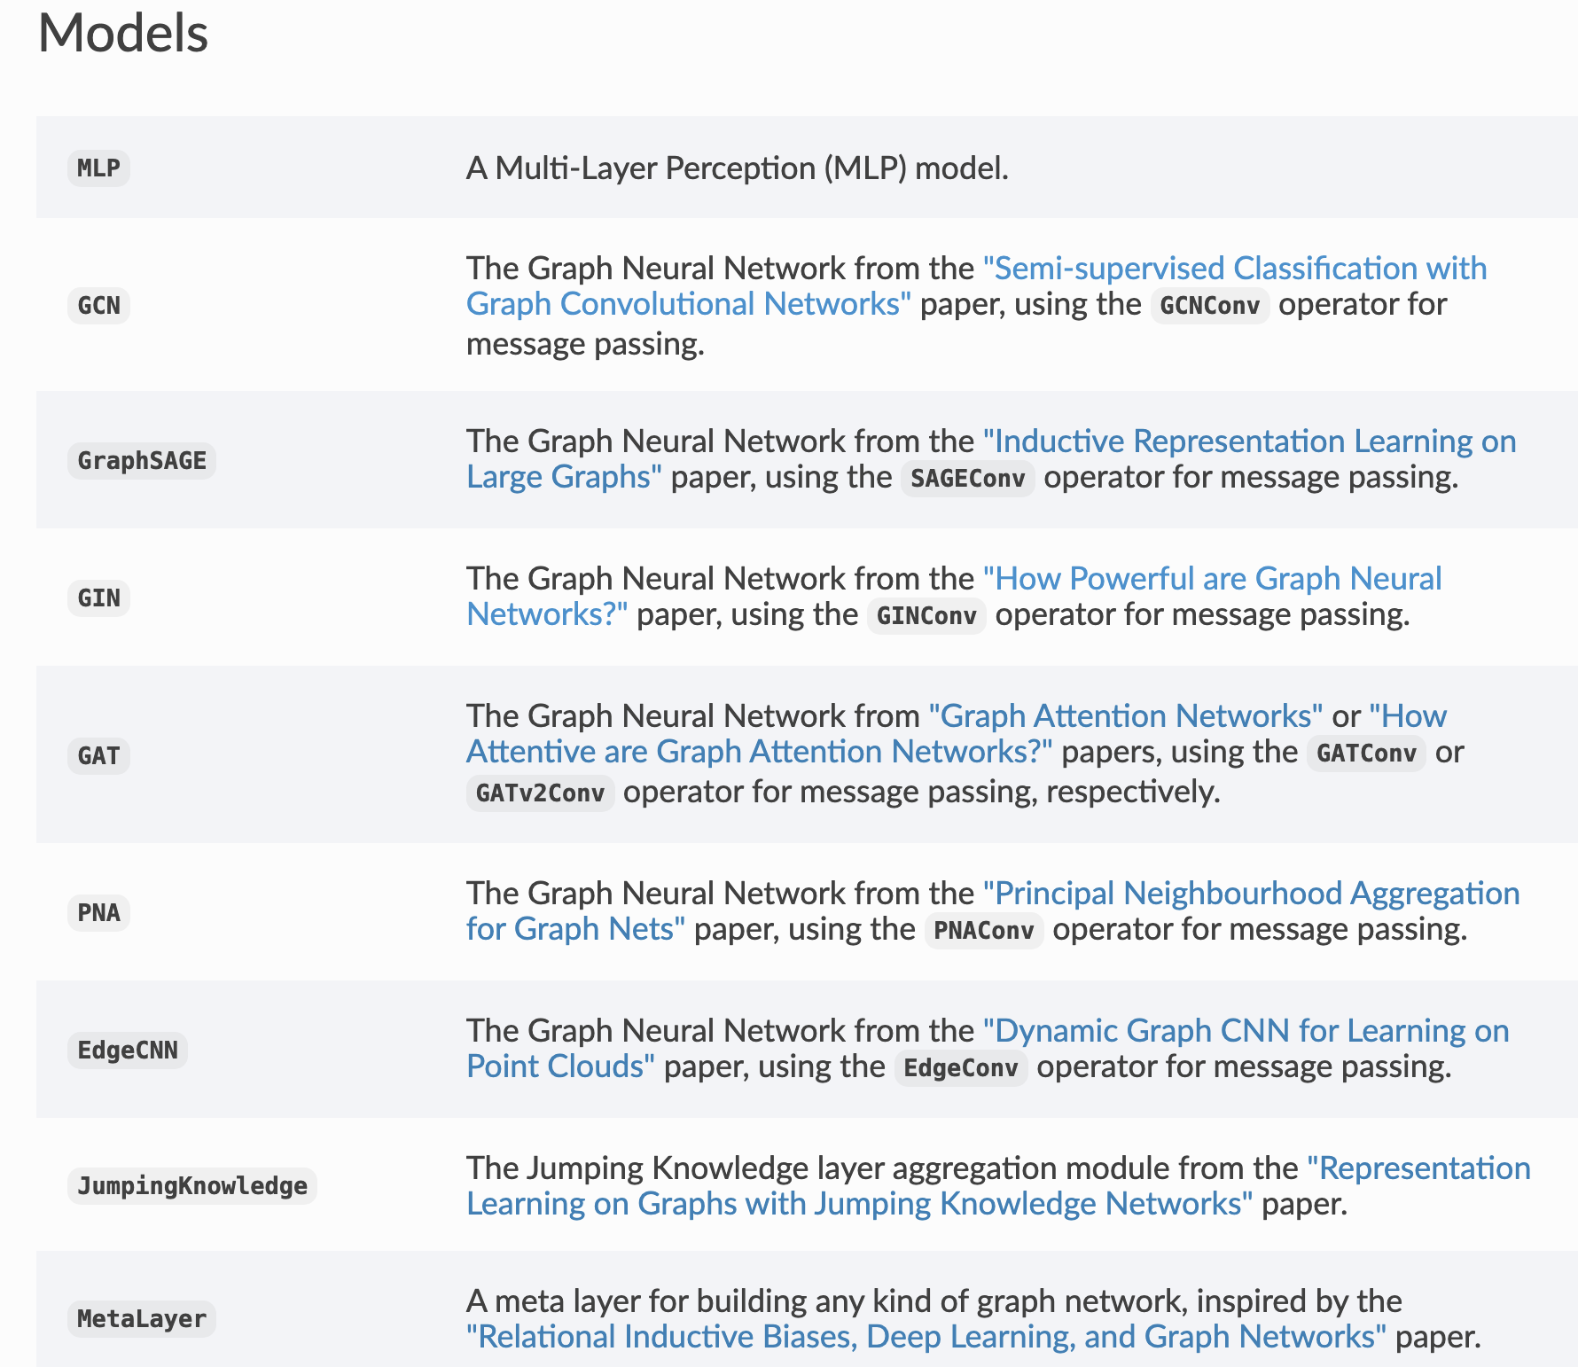
Some General Suggestions
GNNs in pytorch_geometric
https://pytorch-geometric.readthedocs.io/en/2.5.1/index.html

